Slide 1
Group 14 AI Coursework 2 (Group Task)
Authors:
Ali, Hasan
Hussain, Jumail
Mahmood, Abdul-Wahab
Shimizu Felisberto, Matheus
Zhang, Yufei

Slide 2
Roles:
Iterative Deepening: Jumail
Uniform Cost: Matheus and Abdul-Wahab
Best-First: Hasan and Yufei

Slide 3
Iterative Deepening: Explanation
Iterative deepening depth-first search is a state space/graph searching strategy in which a limited version of the DFS is run over and over again while increasing the depth limits until the eventual goal is found. The search start is just as optimal as breadth-first search, however it uses less memory and at every iteration, each node within the search tree is visited the same as DFS, but the increasing order is which the nodes are visited one by one is breadth-first as its most effective.

Slide 4
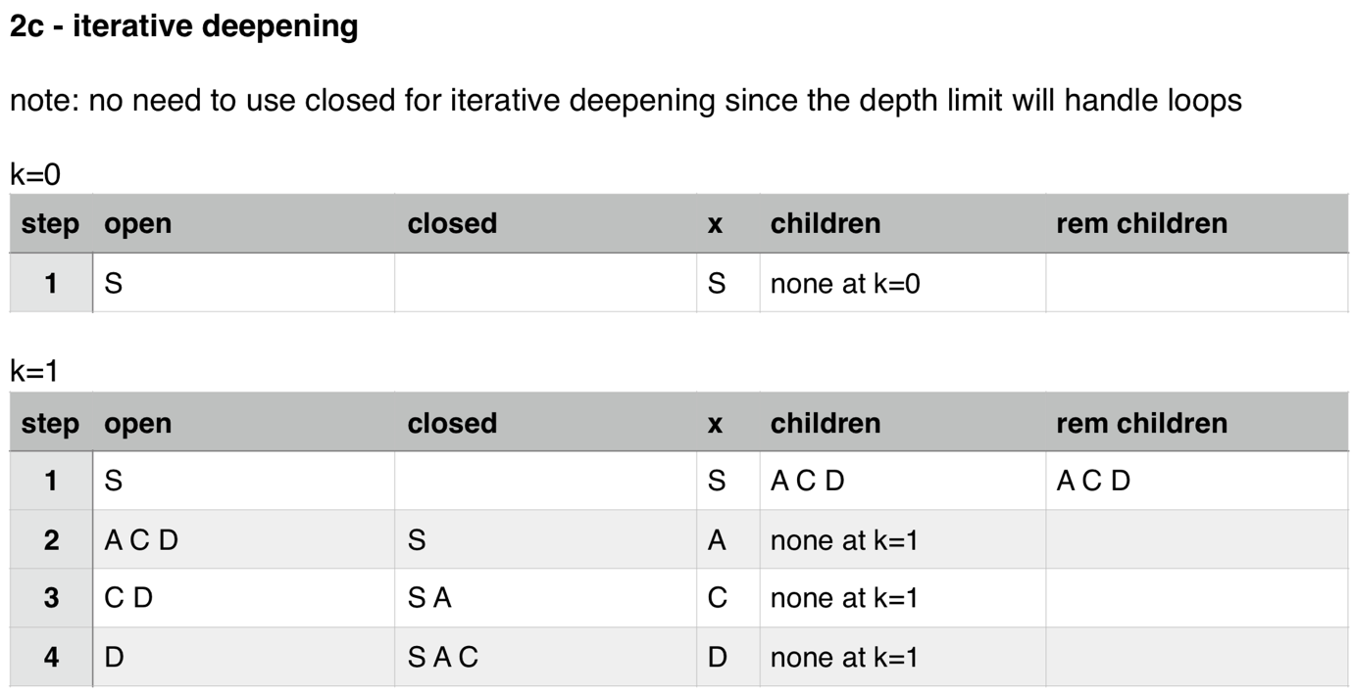
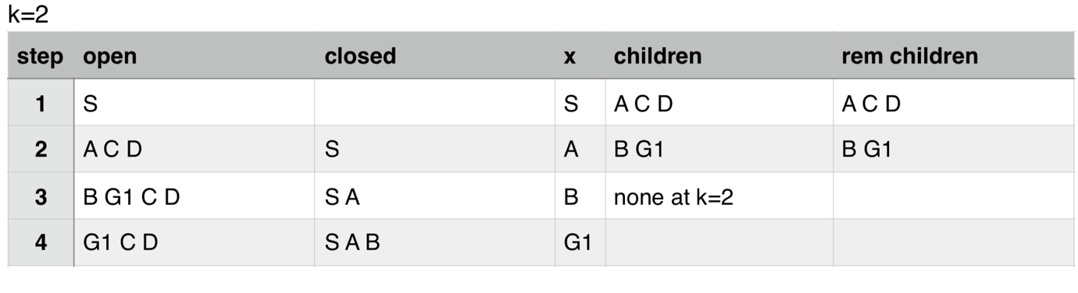
Iterative Deepening: Results

Slide 5
Uniform Cost: Explanation
Uniform cost is considered the best search algorithm that doesn’t involve a heuristic method type. It demands the use of priority queues, such as DFS(Depth-first Search) and BFS(Breadth-first Search). This means that it doesn’t now work through layers but through nodes in the way of DFS or BFS. So this means that the algorithm will not look through all the children nodes of the selected node instead it will simply choose the shortest path each time.

Slide 6
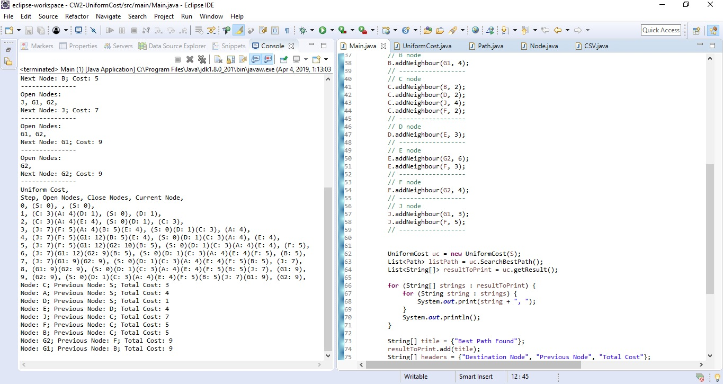
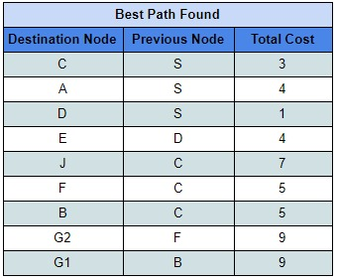
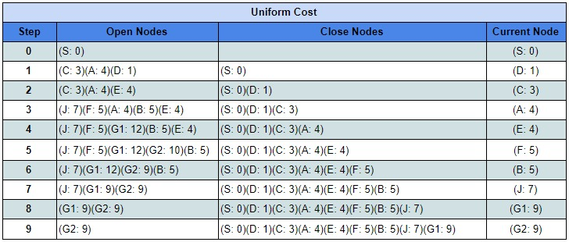
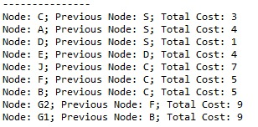
Uniform Cost: Results

Slide 7
Best-First: Explanation
Best first searches the node for the lowest value until its searches the last node of the branch, it will continue the search until it has found the node it is looking for. In our implementation it starts from the node ‘S’ and finishes at the node ‘G1’. From the tree diagram it will search for the lowest node which in this case is ‘C’ it will then continue the search and move down a branch and search for the next value which will be ‘J’ the next node will be ‘G1’ as the cost is 0 and so the program will stop as it has found the node.

Slide 8
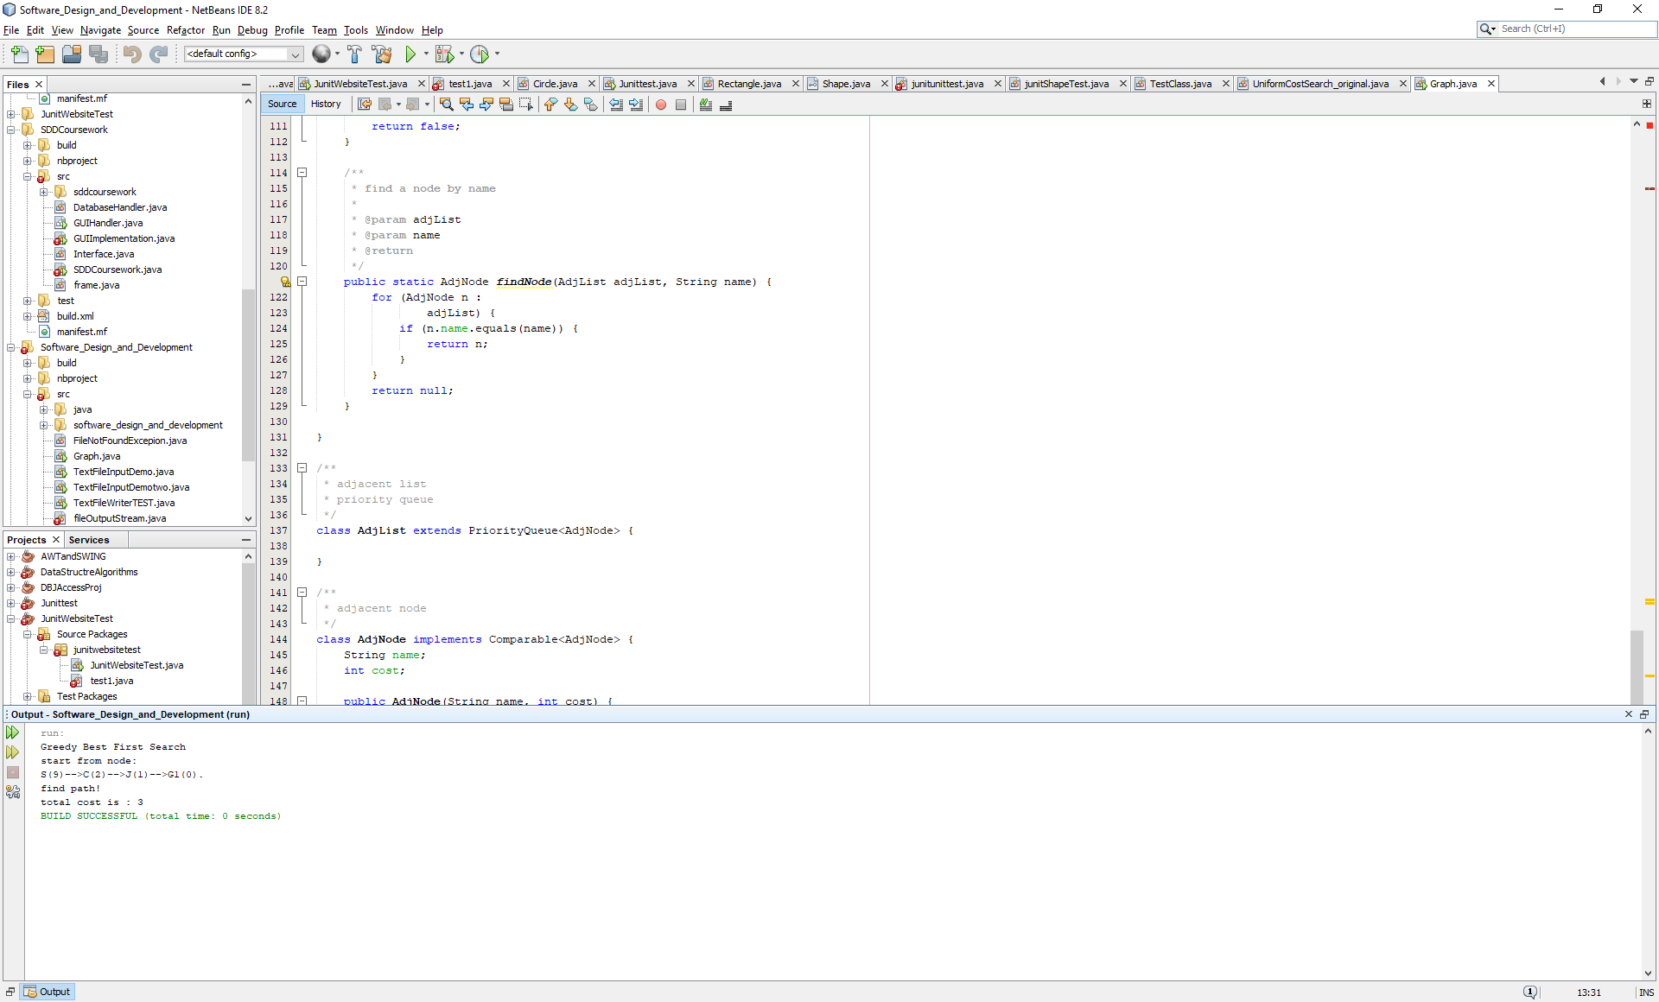
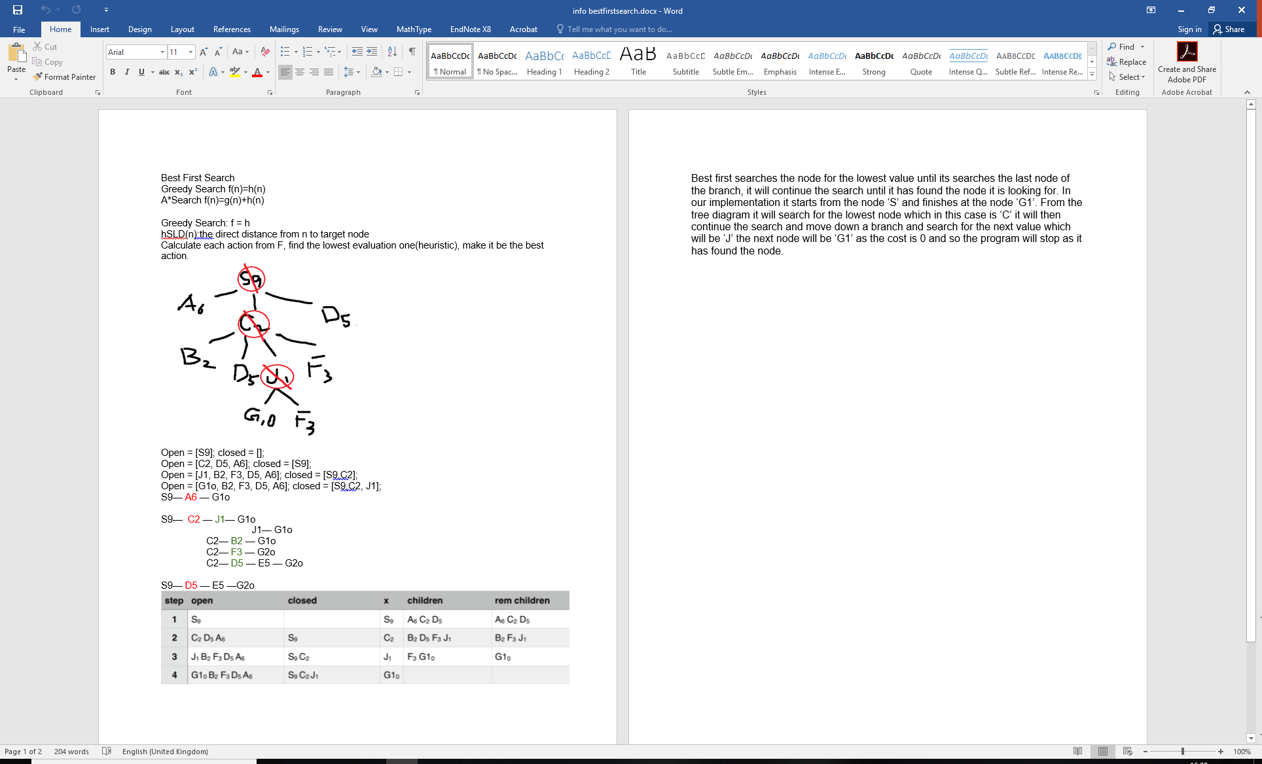
Best-First: Results

Slide 9
Comparison / Analysis
Best first search takes to account the children of the node selected meaning you cannot go back up a branch that has been discovers/used,
However uniform cost takes a look at all the nodes and select the cheapest node to travel down but allows backtracking up nodes to check the overall cheapest path from the parent node to the child. This therefore show that uniform cost search is more accurate compared to BFS which is quicker but less accurate.
Iterative Deepening is the slowest way of the three, however it is still very accurate as it checks all the possible paths.
Therefore BFS is the Quickest algorithm, iterative deepening is the most accurate but Uniform cost is a combination of the two meaning it is the quickest with the best results compared to the others.

Slide 10
Evidence of Group Work
Initially we set up a WhatsApp group chat to discuss the time and whereabouts of the meetings. He agreement came to Thursdays from 11:00 til 12:00 and Fridays 12:00 til 1:00. We had 4 group meetings in total where strategies, implementation and any code related discussion took place.
During the first group meeting, a GitHub repository was also set up so we could share our code and work so we could all work on the tasks in our spare time to make the most of our time and ensure the deadline would be met.

Slide 11
The End
Questions?

